Slide 1
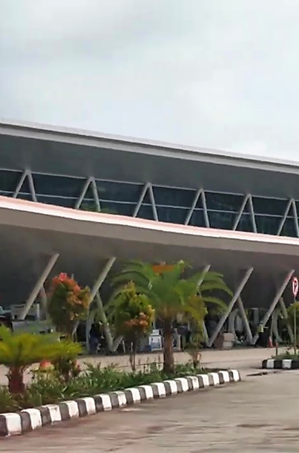

Proposed Solution Benefits
Unified operations, real-time visibility, digitized workflows and AI-led decision support for airport operations.
Unified airport operation
Faster incident response
Airside, terminal, landside, safety and maintenance teams work from a centralized control room for Monitoring and Control of the entire operation .
Alarms, alerts and SOPs move through defined escalation workflows with clear ownership – safety , maintenance , fault to reduce the downtime
Operational Dashboards
KPI’s
IPOC will summaries many operational data points pertaining to Energy , Water , , terminal , airside and landside operation
Important Key Performance indicators are tracked with IPOC to monitor the operational efficiencies
Maintenance
Future-ready AI foundation
All connected asset are monitor in real time and alarm and alerts are escalated to maintenance team and tracked digitally till the closer to achieved SLA
Connected data supports KPI governance, predictive insights and better planning. AI foundation will be able to suggest energy , water saving strategies and also asset failure predication, asset health visibility to reduce the operational costs
The proposed outcomes listed below are examples and are subject to the availability of data from the integrated systems. These projections may change after a detailed study of the underlying systems and confirmation from the respective vendors on dataset availability.

Slide 2
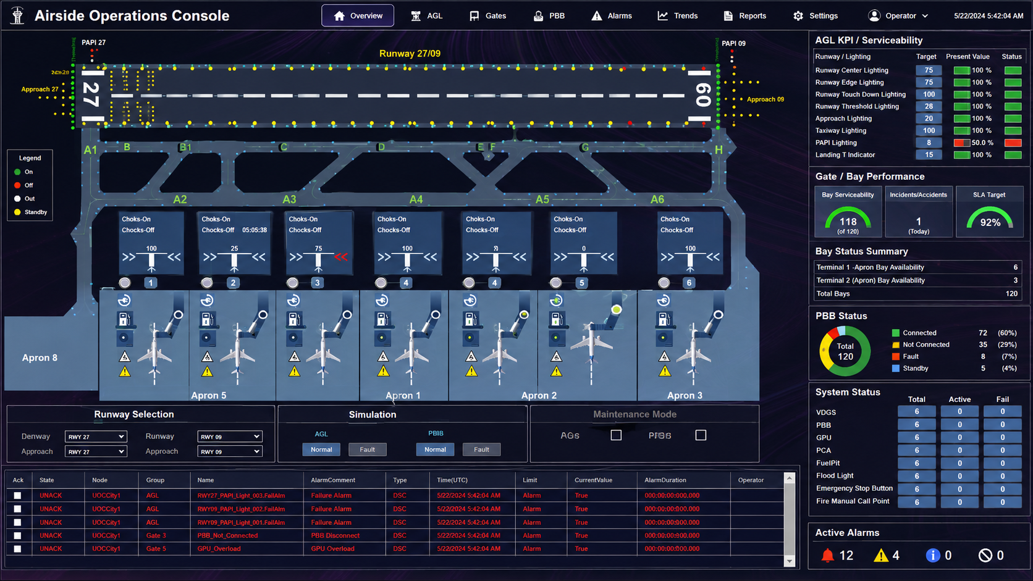
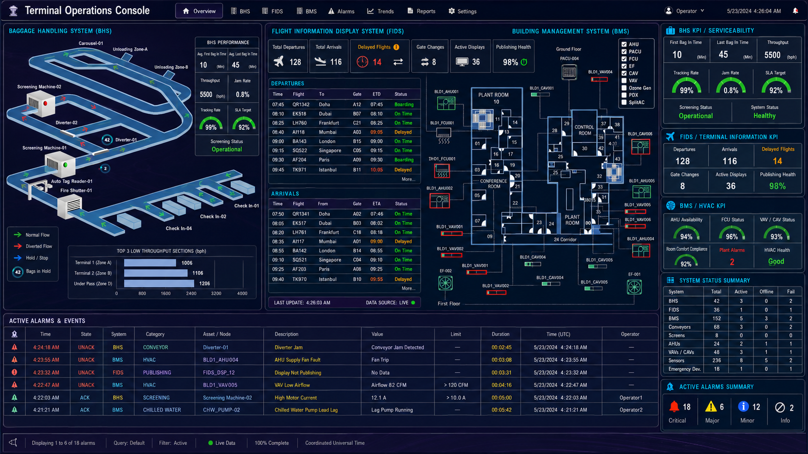
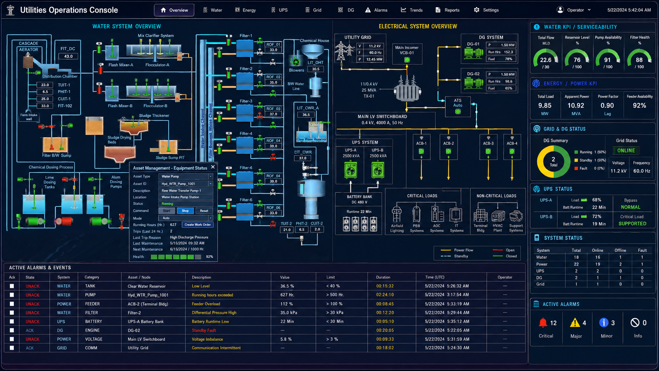
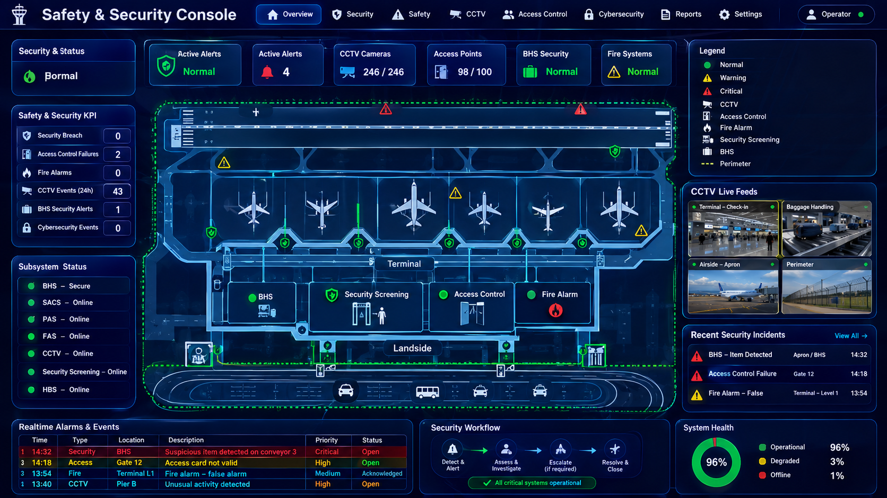
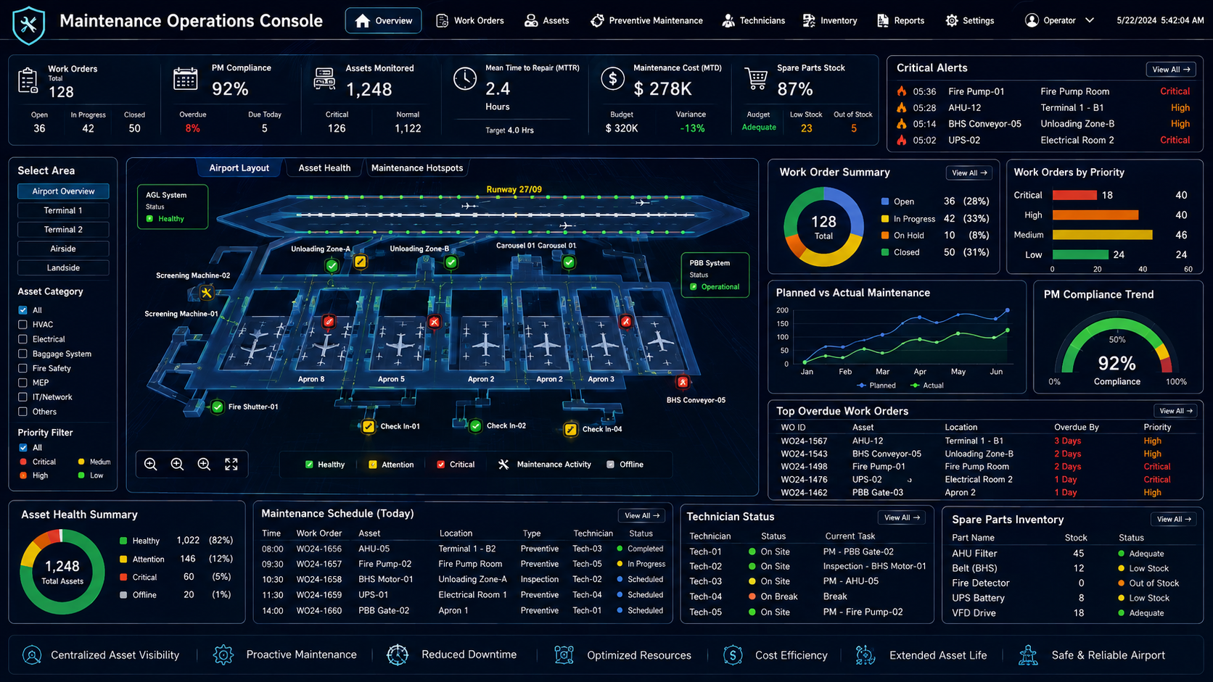
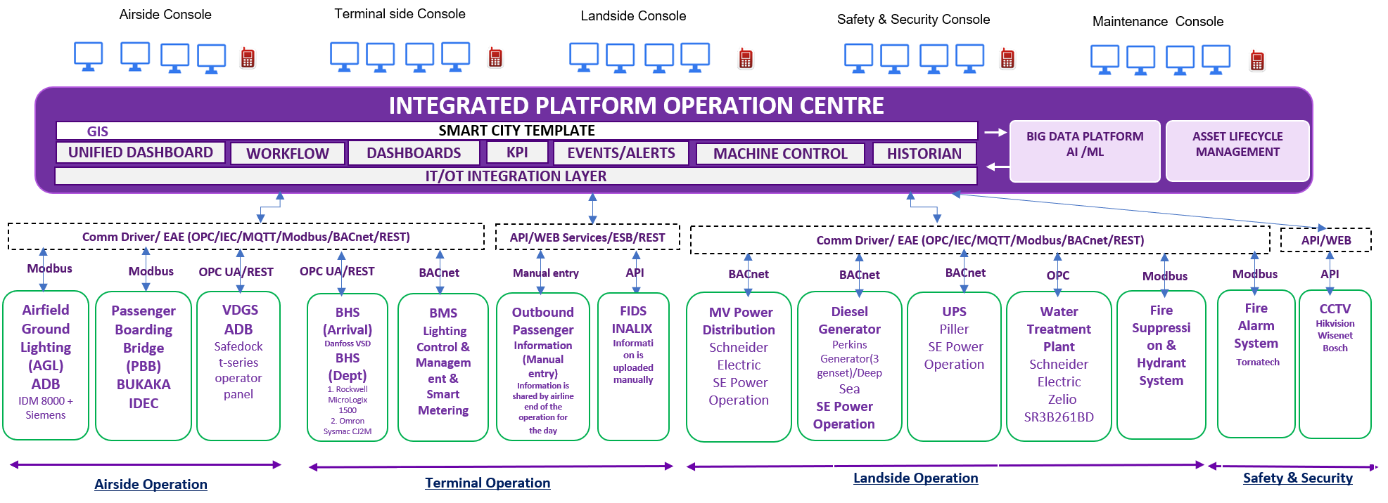
UNIFIED AIRPORT OPERATION
Airside, terminal, landside, safety and maintenance teams work from a centralized control room for Monitoring and Control of the entire operation .
AIRSIDE OPERATION CONSOLE
TERMINAL OPERATION CONSOLE
LANDSIDE OPERATION CONSOLE
SAFETY SECURITY OPERATION CONSOLE
MAINTENANCE CONSOLE
Unified Airside Ops- AGL, VGDS, PBB

Slide 3
UNIFIED AIRPORT OPERATION
Airside, terminal, landside, safety and maintenance teams work from a centralized control room for Monitoring and Control of the entire operation .
AIRSIDE OPERATION CONSOLE

Slide 4
UNIFIED AIRPORT OPERATION
Airside, terminal, landside, safety and maintenance teams work from a centralized control room for Monitoring and Control of the entire operation .
TERMINAL OPERATION CONSOLE

Slide 5
UNIFIED AIRPORT OPERATION
Airside, terminal, landside, safety and maintenance teams work from a centralized control room for Monitoring and Control of the entire operation .
LANDSIDE OPERATION CONSOLE

Slide 6
UNIFIED AIRPORT OPERATION
Airside, terminal, landside, safety and maintenance teams work from a centralized control room for Monitoring and Control of the entire operation .
SAFETY SECURITY OPERATION CONSOLE

Slide 7
UNIFIED AIRPORT OPERATION
Airside, terminal, landside, safety and maintenance teams work from a centralized control room for Monitoring and Control of the entire operation .
MAINTENANCE CONSOLE

Slide 8
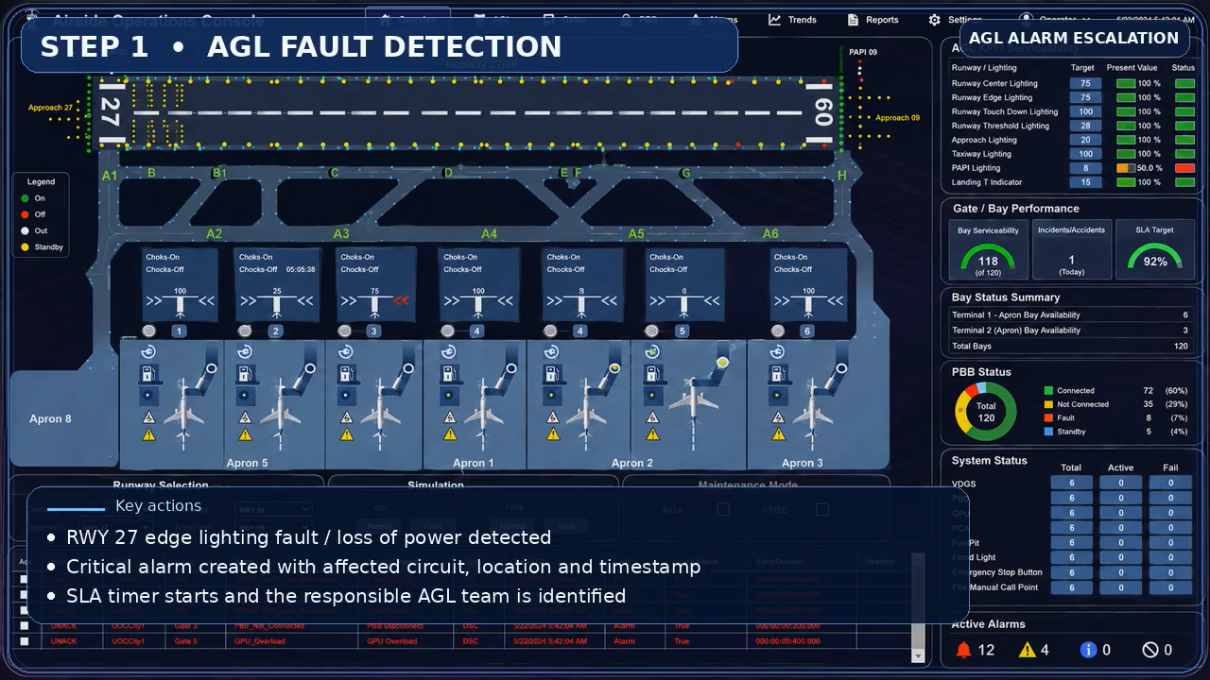

Faster incident response
Alarms, alerts and SOPs move through defined escalation workflows with clear ownership – safety , maintenance , fault to reduce the downtime
Asset Failure incidence management
Safety incidence management

Slide 9
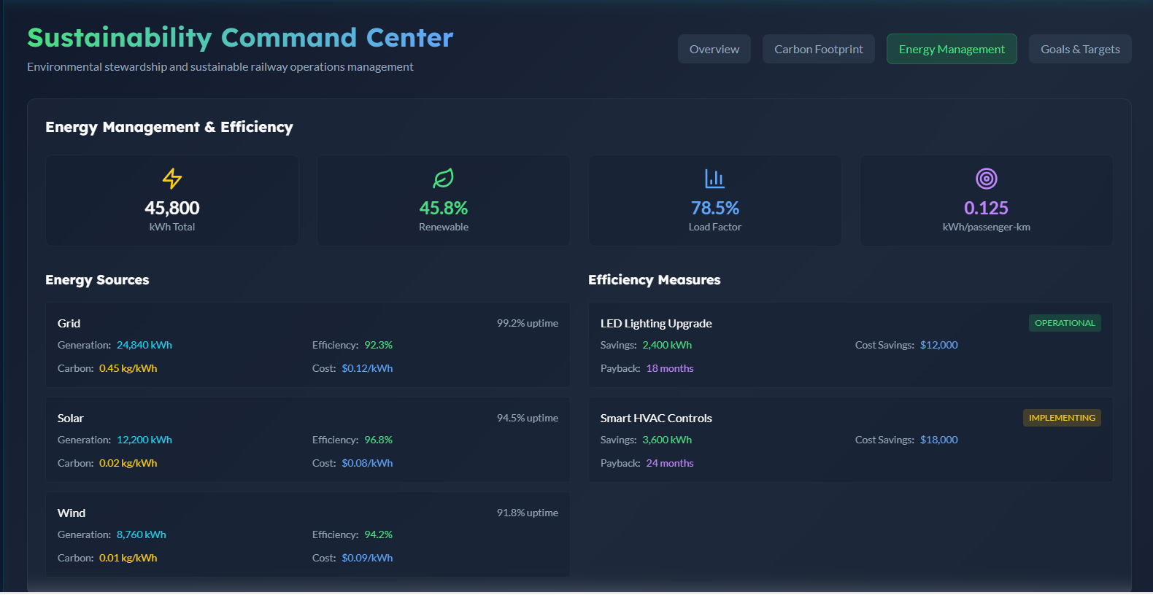
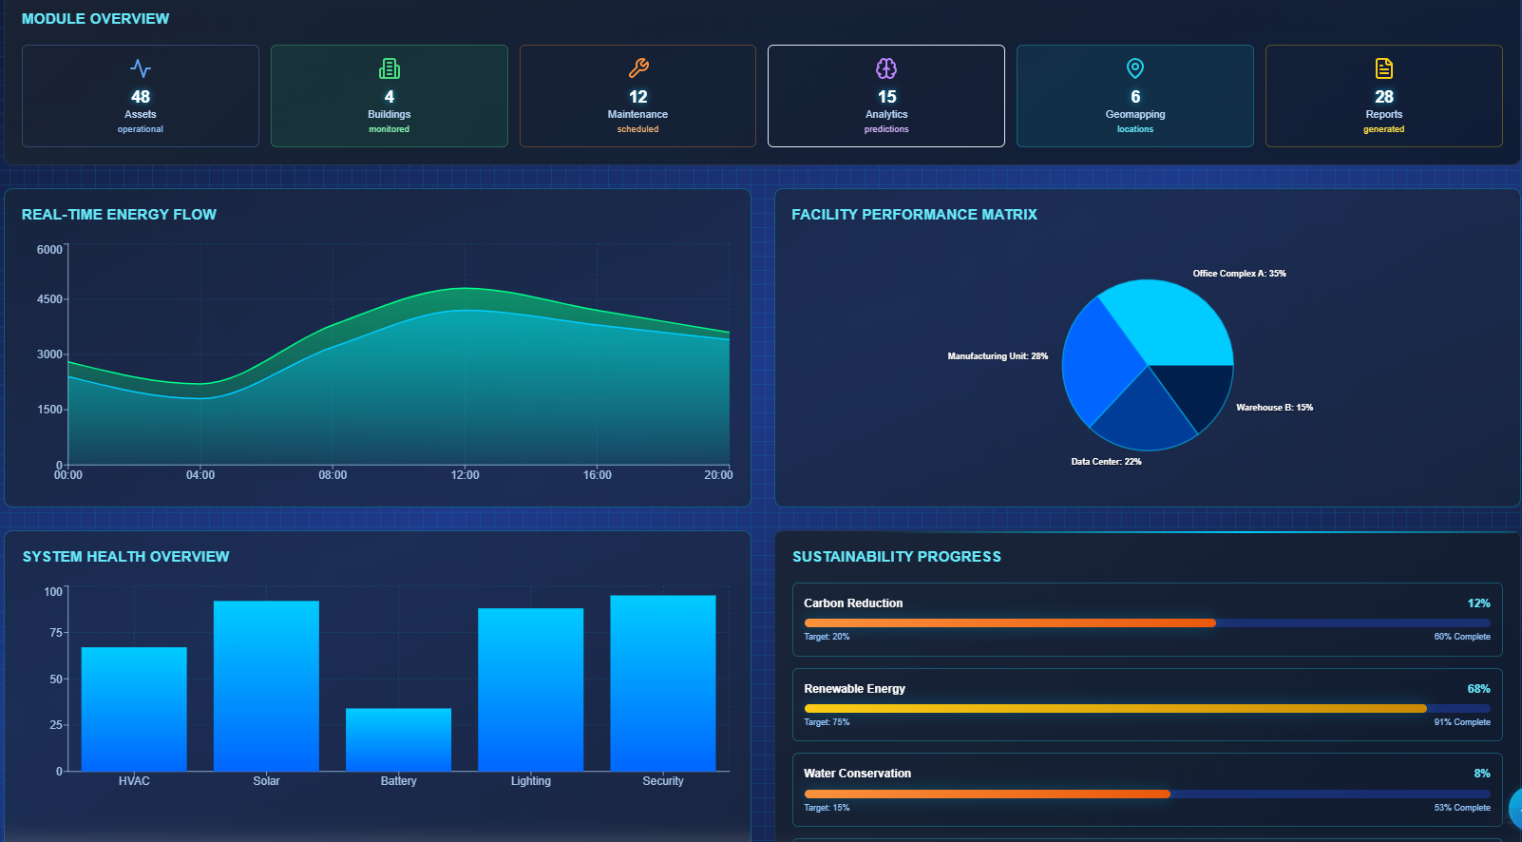
Operational Dashboards
IPOC will summaries many operational data points pertaining to Energy , Water , terminal , airside and landside operation
Shows total energy use, load factor, and per-passenger-km efficiency, broken down by grid/solar/wind sources and efficiency initiatives like LED and smart HVAC upgrades.
Dashboard shows real-time energy flow, facility-wise performance distribution, system health by category, and progress toward carbon, renewable, and water conservation targets.

Slide 10
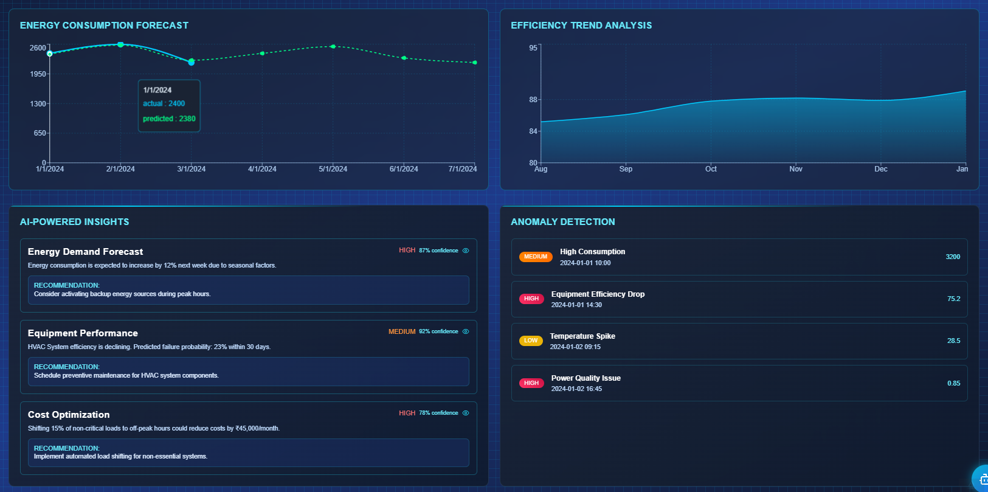
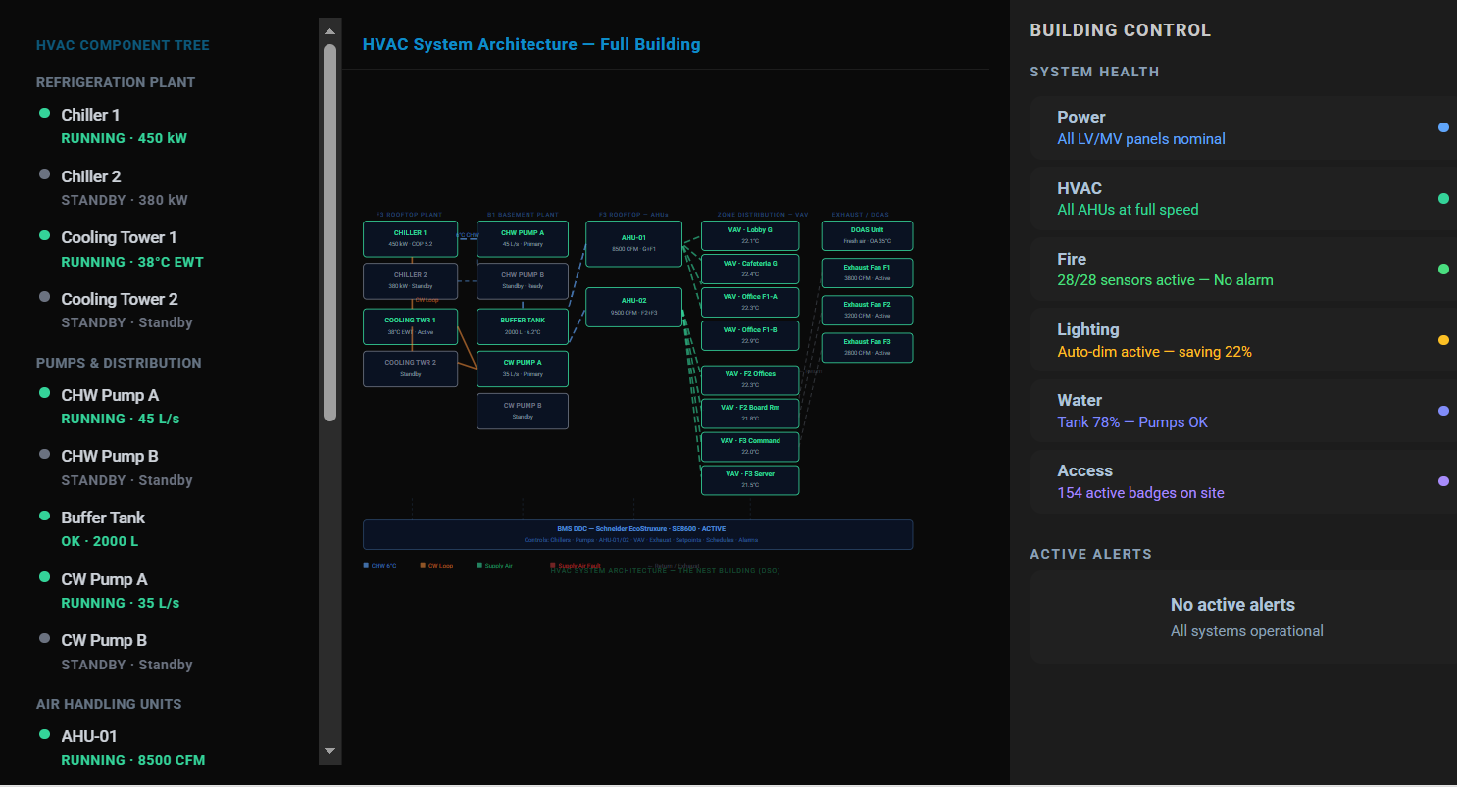
Operational Dashboards
IPOC will summaries many operational data points pertaining to Energy , Water , , terminal , airside and landside operation
Combines an actual-vs-predicted energy forecast and efficiency trend with AI-generated insights (demand spikes, HVAC failure risk, cost optimization) and an anomaly detection feed flagging equipment and power quality issues.
Full building HVAC component tree and flow diagram showing live status of chillers, cooling towers, pumps, and air handling units, alongside overall building system health and active alerts.

Slide 11
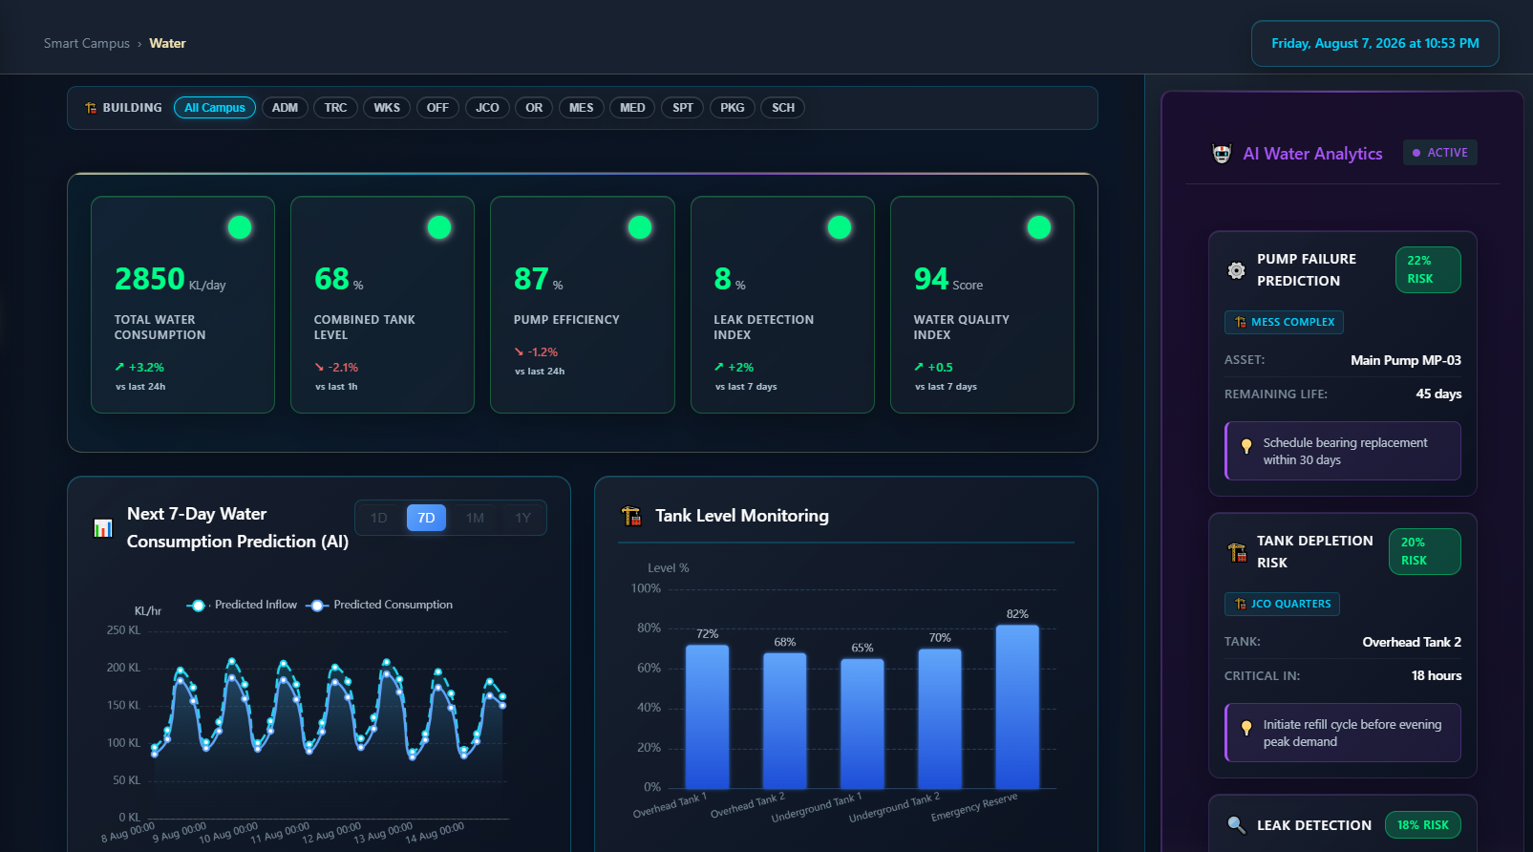
Operational Dashboards
IPOC will summaries many operational data points pertaining to Energy , Water , , terminal , airside and landside operation
Tracks water metrics with a 7-day AI consumption forecast and tank level monitoring across buildings.

Slide 12
Operational Dashboards
IPOC will summaries many operational data points pertaining to Energy , Water , , terminal , airside and landside operation
Example of Monitoring building Operation

Slide 13
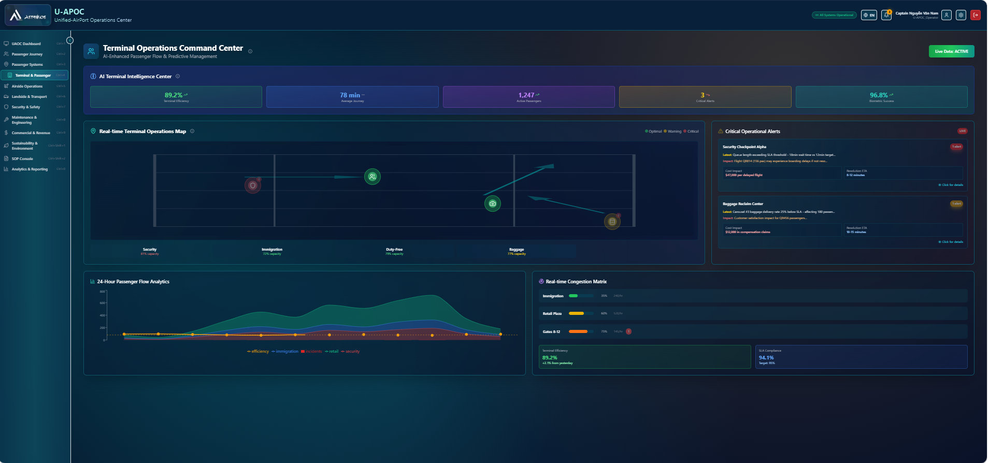
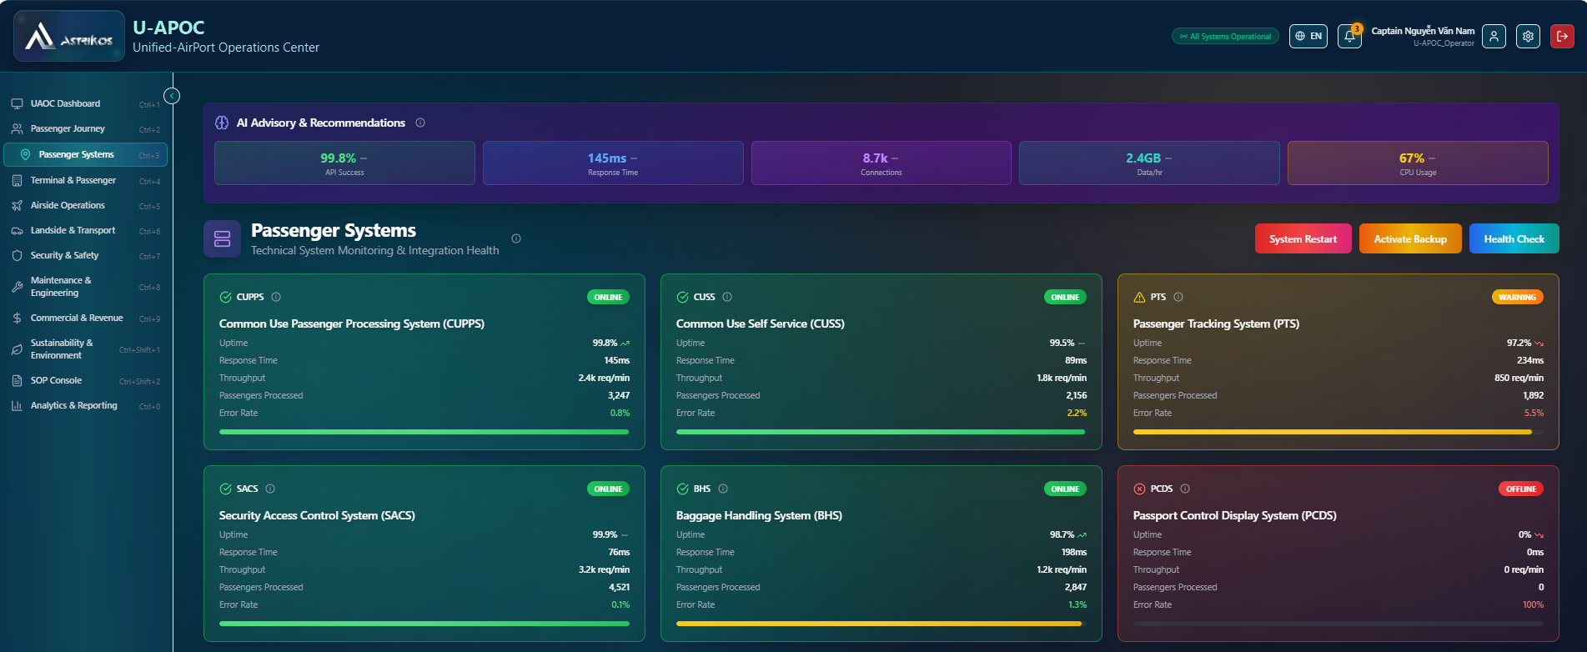
KPI’s
Important Key Performance indicators are tracked with IPOC to monitor the operational efficiencies
.
This U-APOC platform, uses AI to track live terminal efficiency, passenger journey time, active passengers, and biometric success, with a real-time congestion map across security, immigration, duty-free, and baggage zones.
IPOC platform, monitors the health of core airport systems like PBB, VDGS, BHS, and PCDS with live uptime, response time, throughput, and error rate metrics.

Slide 14
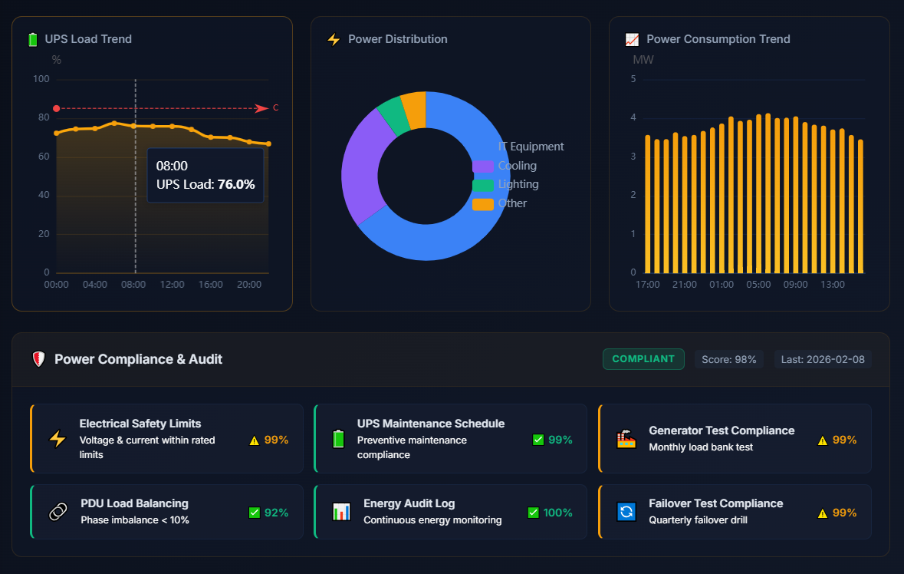
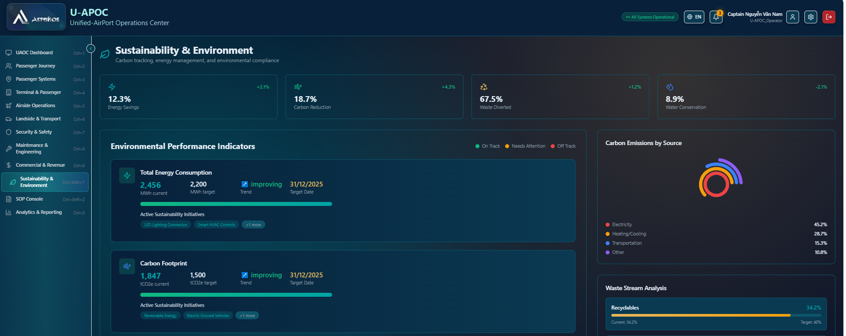
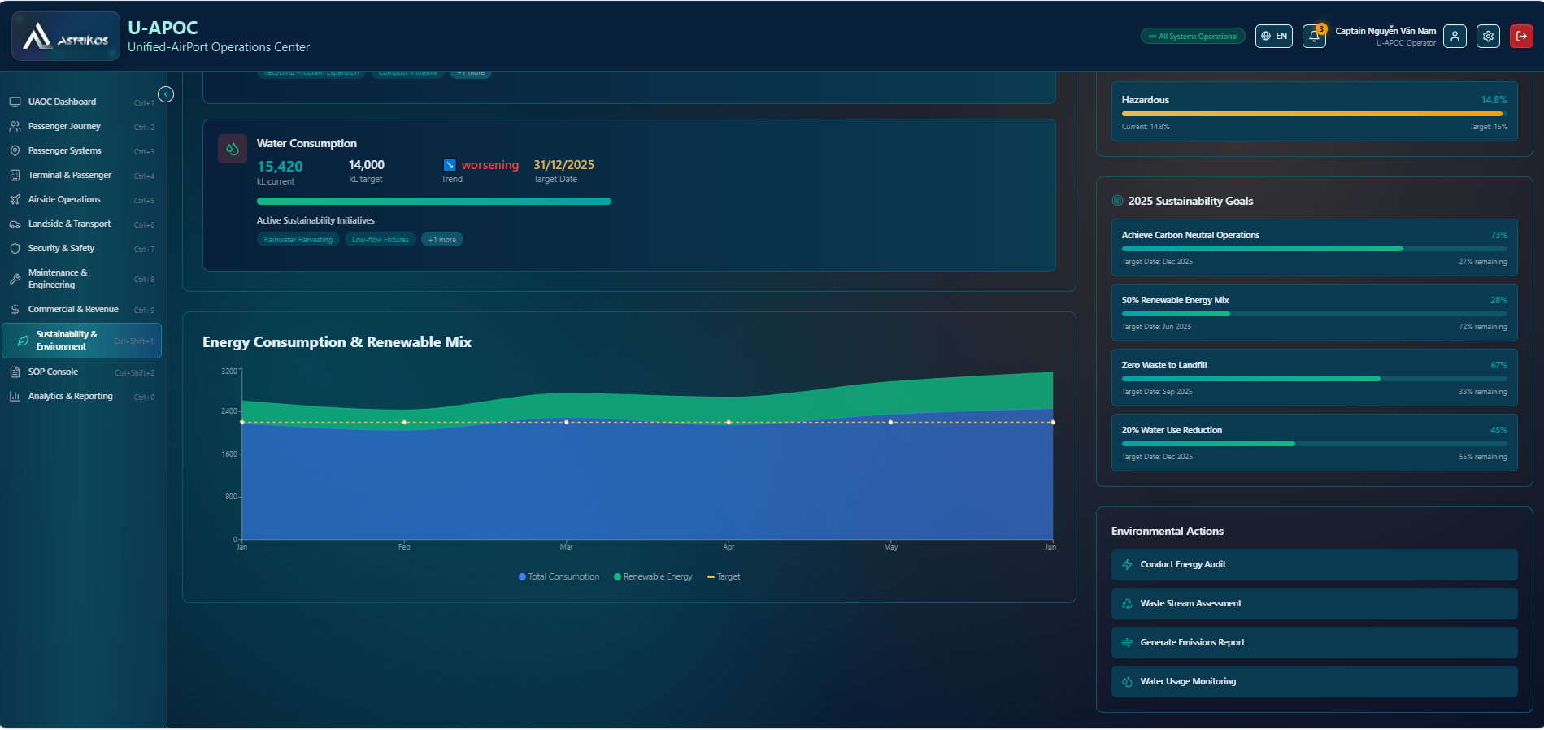
KPI’s
Important Key Performance indicators are tracked with IPOC to monitor the operational efficiencies
Tracks UPS load, power distribution by category (IT, cooling, lighting), and power consumption trends, likely for a data centre facility.
Tracks carbon emissions, energy, waste, and water metrics against targets, alongside active initiatives like LED conversions and electric ground vehicles.

Slide 15
Maintenance
All connected asset are monitor in real time and alarm and alerts are escalated to maintenance team and tracked digitally till the closer to achieved SLA
.
Maintenance operations console
Airport asset scope
• Airside: AGL, PBB and VDGS
• Terminal: BHS, FIDS, BMS/HVAC, lifts and escalators
• Safety & security: CCTV, fire alarm and access/security devices
• Utilities: water system, UPS, DG and related electrical assets
Asset management principles
1. Common asset hierarchy
Standard asset register, location, tag and OEM details for every connected asset.
2. Criticality and risk
Rank by safety impact, operational impact, redundancy and maintainability.
3. Condition visibility
Use alarms, runtime, health indicators and inspection data to see asset condition.
4. Closed-loop work management
Escalate incidents into work orders and track response, restore and closure SLA.
Screen-style monitoring with work orders, asset health, technician status, spares and alarm-based maintenance.
Outcome: one maintenance console linking real-time asset condition, work execution and service accountability.
Benefits are indicative and depend on data availability, integration readiness and vendor support.

Slide 16

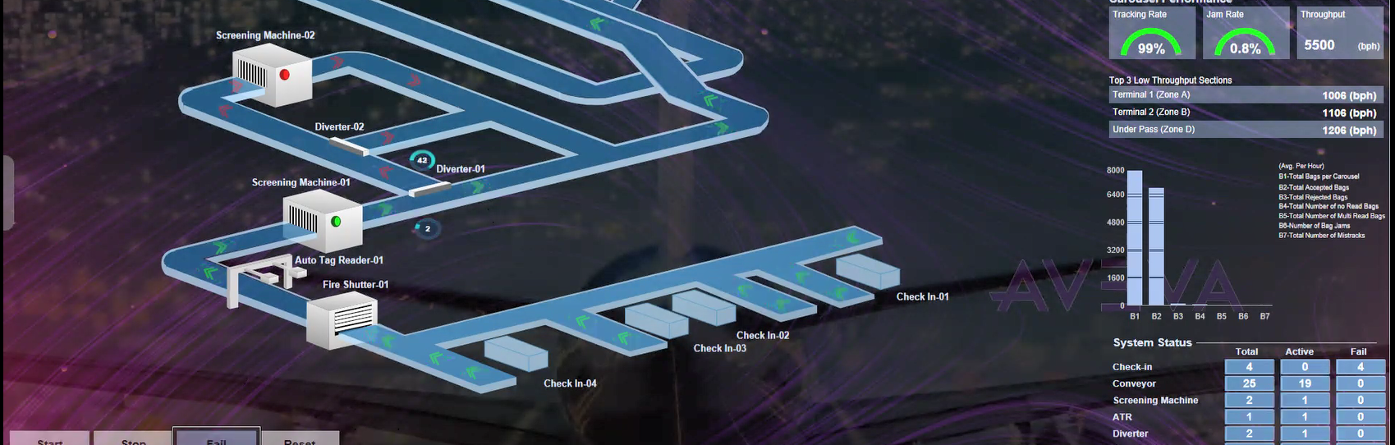
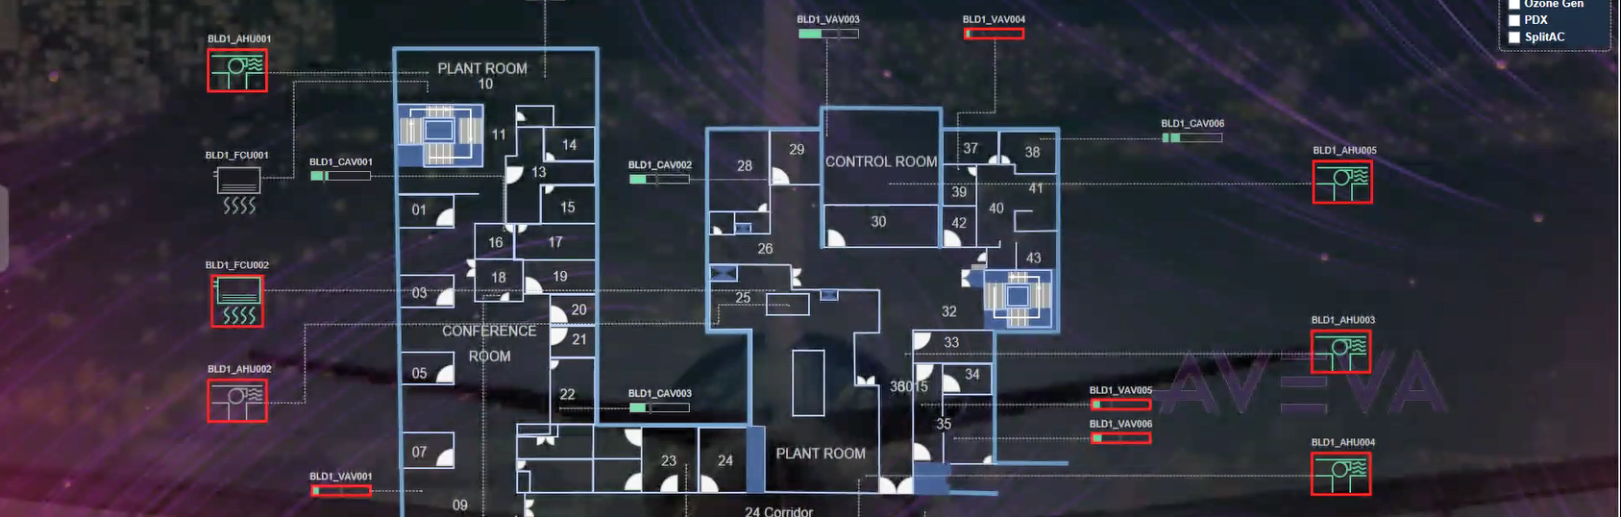
Maintenance
All connected asset are monitor in real time and alarm and alerts are escalated to maintenance team and tracked digitally till the closer to achieved SLA
Airside assets
Terminal baggage
Building systems
AGL • PBB • VDGS
BHS conveyors, sorters and scanners
HVAC, chiller, pumps and BMS
Safety & security
Utilities & power
CCTV, fire alarm and critical interfaces
Water, UPS, DG and electrical systems
Maintenance scope focus
Each asset class follows the same maintenance principles: standard master data, criticality ranking, inspection plans, alarm-based response, preventive tasks, condition monitoring, spare-parts linkage and service history.
Benefits are indicative and depend on data availability, integration readiness and vendor support.

Slide 17
Maintenance
All connected asset are monitor in real time and alarm and alerts are escalated to maintenance team and tracked digitally till the closer to achieved SLA
Maintenance KPI and work management view
Suggested KPI and SLA focus
• Asset availability and serviceability by criticality class
• MTBF, MTTR, critical alarm response time and closure SLA
• PM compliance, preventive backlog and repeat failure rate
• Spare-parts availability and technician productivity
Predictive and condition-based maintenance use cases
AGL / PBB / VDGS
Detect abnormal lamp, bridge, docking or controller behaviour before failure.
BHS / FIDS
Predict conveyor motor issues, jam conditions and support faster terminal recovery.
BMS / HVAC / Water
Identify pump, chiller, AHU and water-treatment degradation early.
UPS / DG / CCTV
Monitor battery health, start readiness, recording health and communications.
Availability
Critical airport assets available and serviceable when needed.
MTTR / response
Track acknowledgement, response and restoration time.
PM compliance
Ensure preventive tasks are planned and completed on time.
Backlog / repeat faults
Control overdue work orders and recurring failures.
Expected benefit: lower downtime, better SLA compliance, stronger asset reliability and more disciplined lifecycle management.
Benefits are indicative and depend on data availability, integration readiness and vendor support.

Slide 18
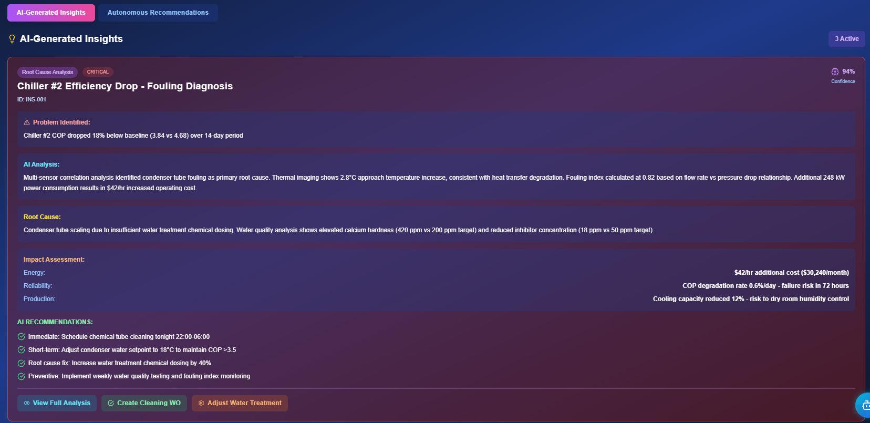
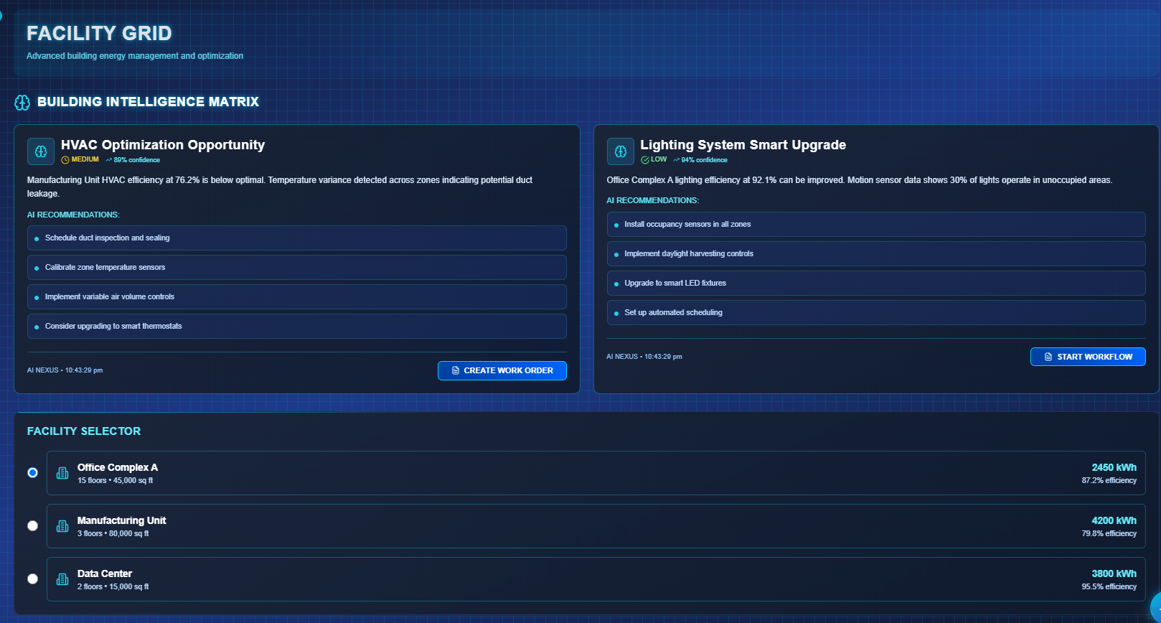
Future-ready AI foundation
Connected data supports KPI governance, predictive insights and better planning. AI foundation will be able to suggest energy , water saving strategies and also asset failure predication to reduce the operational costs
AI root-cause analysis diagnosing condenser tube fouling in Building management from insufficient water treatment, quantifying cost impact and failure risk, with actionable cleaning and water-treatment recommendations.
AI-detected optimization opportunities across facilities: HVAC duct leakage at the Manufacturing Unit and underused lighting sensors at Office Complex , each with confidence scores and a one-click workflow/work-order action.
Benefits are indicative and depend on data availability, integration readiness and vendor support.

Slide 19
Future-ready AI foundation
Connected data supports KPI governance, predictive insights and better planning. AI foundation will be able to suggest energy , water saving strategies and also asset failure predication to reduce the operational costs
Benefits are indicative and depend on data availability, integration readiness and vendor support.

